Slide 1
Two Port Network
Linear Circuit Analysis II
EECE 202

Slide 2
Lecture Objectives
Two port networks.
(Y) and (Z) parameters.

Slide 3
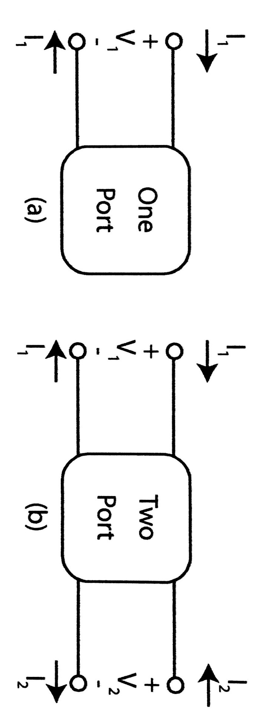
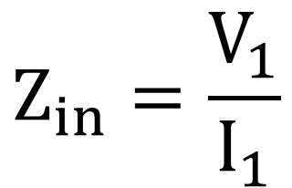
One port and two port networks
$$Z_{in}=\frac{V_{1}}{I_{1}}$$
Z parameters

Slide 4
Two port networks
Z parameters
H parameters
Y parameters
T parameters

Slide 5

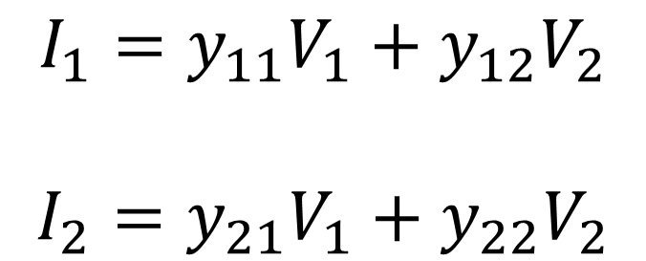
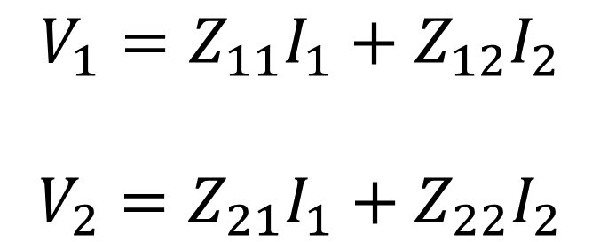
Two Port Networks
Y parameters
$$I_{1}=y_{11}V_{1}+y_{12}V_{2}$$
$$I_{2}=y_{21}V_{1}+y_{22}V_{2}$$
Z parameters
$$V_{1}=Z_{11}I_{1}+Z_{12}I_{2}$$
$$V_{2}=Z_{21}I_{1}+Z_{22}I_{2}$$

Slide 6
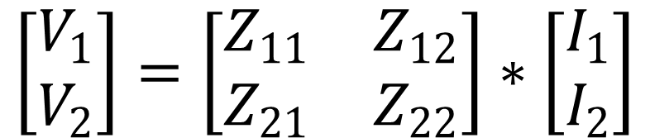
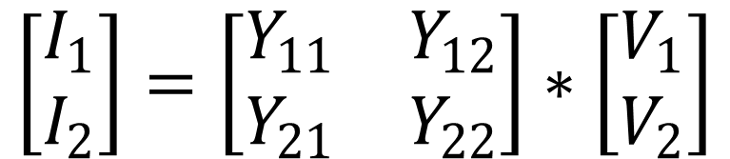
Two port networks
Z parameters of the two
Port network.
Z parameters
$$\left[\begin{matrix}V_{1} \\ V_{2}\end{matrix}\right]=\left[\begin{matrix}Z_{11} & Z_{12} \\ Z_{21} & Z_{22}\end{matrix}\right]∗\left[\begin{matrix}I_{1} \\ I_{2}\end{matrix}\right]$$
Y parameters of the two
Port network.
Y parameters
$$\left[\begin{matrix}I_{1} \\ I_{2}\end{matrix}\right]=\left[\begin{matrix}Y_{11} & Y_{12} \\ Y_{21} & Y_{22}\end{matrix}\right]∗\left[\begin{matrix}V_{1} \\ V_{2}\end{matrix}\right]$$

Slide 7
Two Port Networks
Z parameters
Use mesh analysis
Y parameters
Use Nodal analysis

Slide 8
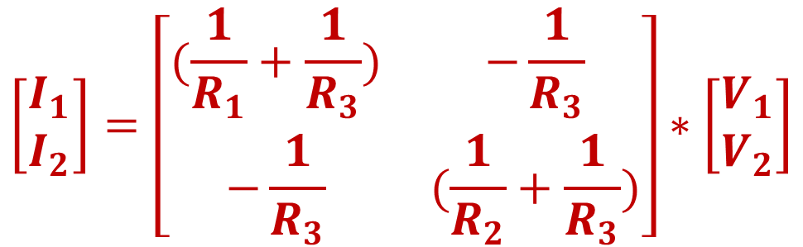
Two port network
Compute the admittance (Y) parameters of the circuit shown
I1
I2
R3
+
+
V1
R1
R2
V2
-
-
$$\left[\begin{matrix}I_{1} \\ I_{2}\end{matrix}\right]=\left[\begin{matrix}(\frac{1}{R_{1}}+\frac{1}{R_{3}}) & −\frac{1}{R_{3}} \\ −\frac{1}{R_{3}} & (\frac{1}{R_{2}}+\frac{1}{R_{3}})\end{matrix}\right]∗\left[\begin{matrix}V_{1} \\ V_{2}\end{matrix}\right]$$

Slide 9
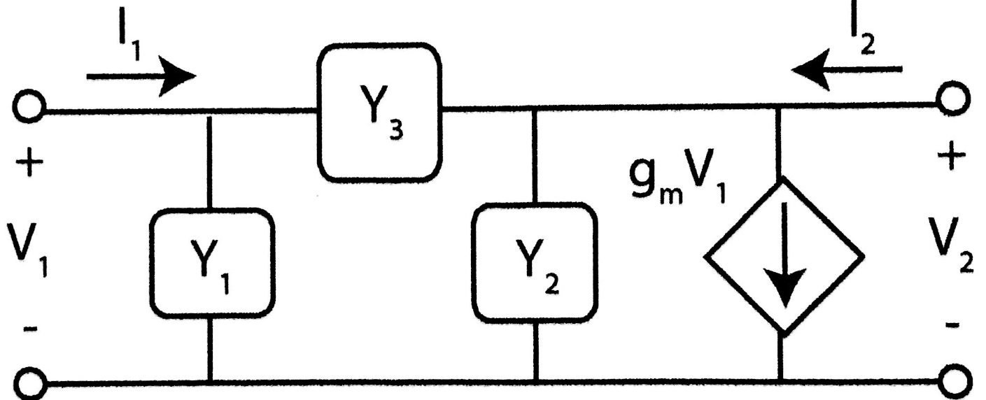
Two port network
Compute the admittance (Y) parameters of the circuit shown
$$\left[\begin{matrix}I_{1} \\ I_{2}\end{matrix}\right]=\left[\begin{matrix}Y_{1}+Y_{3} & {−Y}_{3} \\ g_{m}−Y_{3} & Y_{2}+Y_{3}\end{matrix}\right]∗\left[\begin{matrix}V_{1} \\ V_{2}\end{matrix}\right]$$

Slide 10
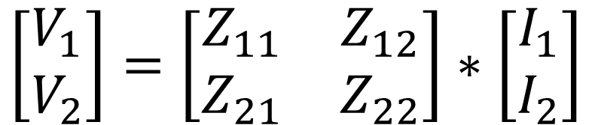
Two port networks
Z parameters
Z parameters of the two
Port network.
$$\left[\begin{matrix}V_{1} \\ V_{2}\end{matrix}\right]=\left[\begin{matrix}Z_{11} & Z_{12} \\ Z_{21} & Z_{22}\end{matrix}\right]∗\left[\begin{matrix}I_{1} \\ I_{2}\end{matrix}\right]$$

Slide 11
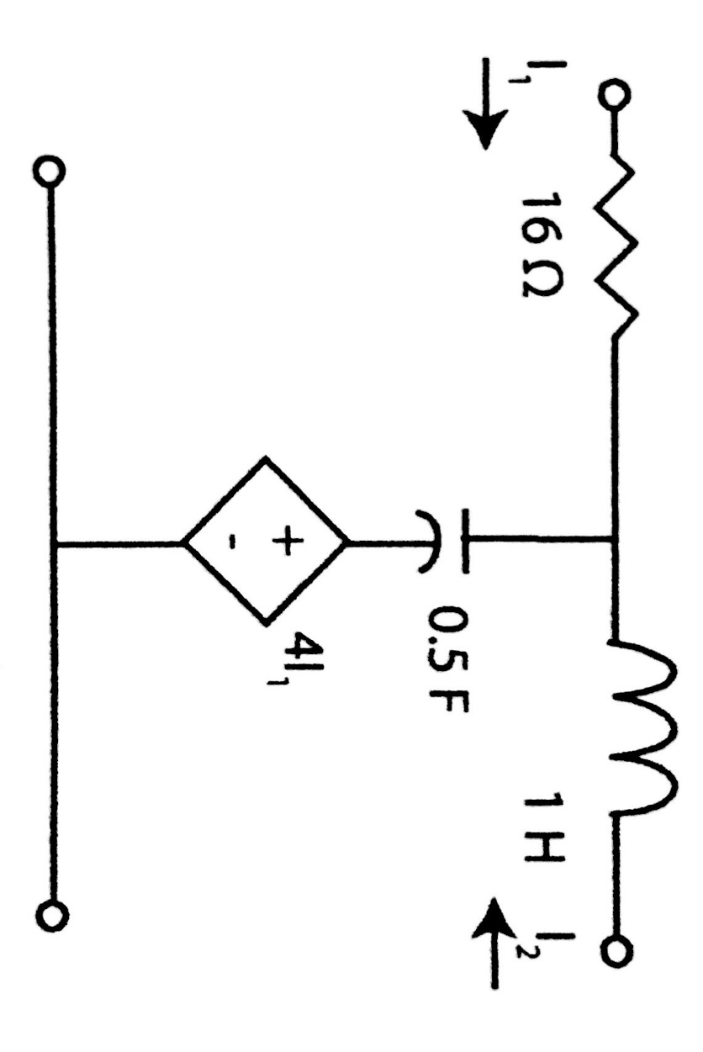
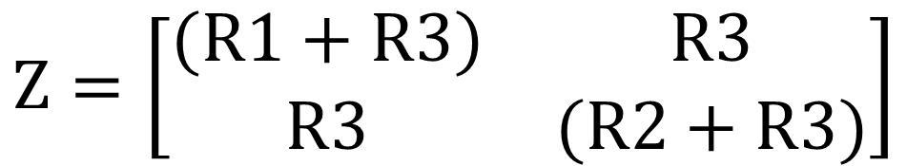
Two port network
Compute the impedance (Z) parameters of the circuit shown
R1
R2
$$Z=\left[\begin{matrix}(R1+R3) & R3 \\ R3 & (R2+R3)\end{matrix}\right]$$
V1
V2
R3

Slide 12
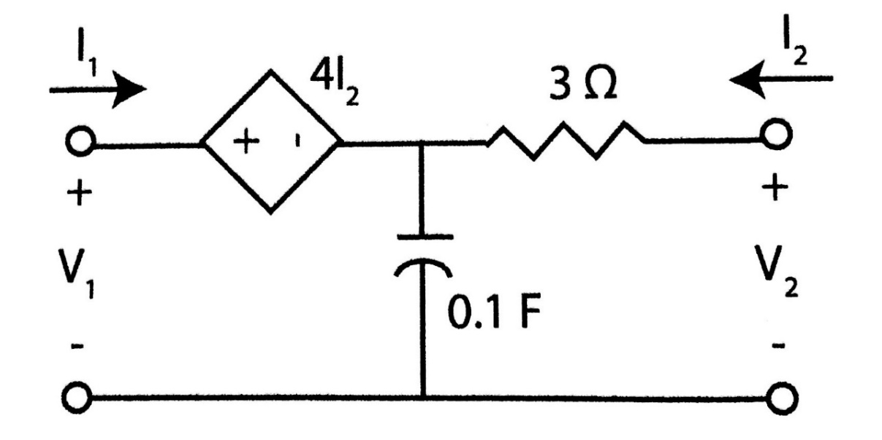
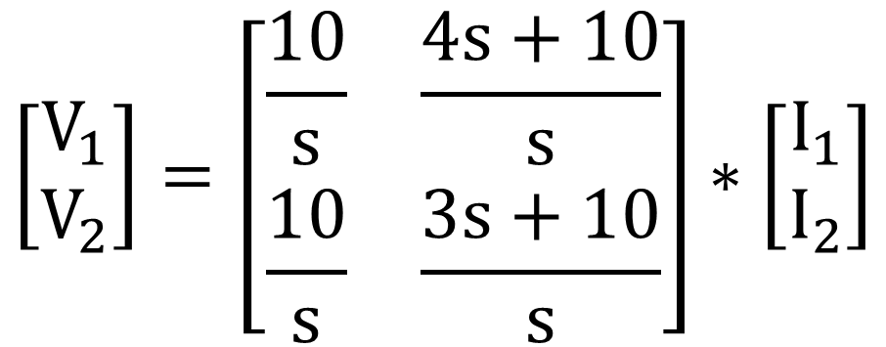
Two port network
Compute the impedance (Z) parameters of the circuit shown
$$\left[\begin{matrix}V_{1} \\ V_{2}\end{matrix}\right]=\left[\begin{matrix}\frac{10}{s} & \frac{4s+10}{s} \\ \frac{10}{s} & \frac{3s+10}{s}\end{matrix}\right]∗\left[\begin{matrix}I_{1} \\ I_{2}\end{matrix}\right]$$

Slide 13

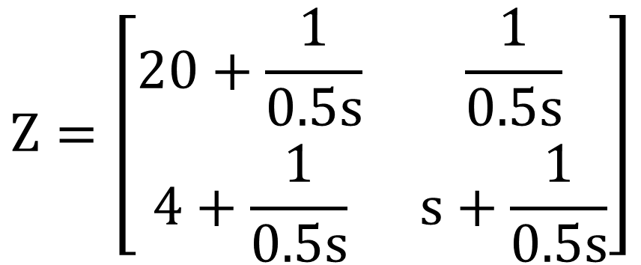
Two port network
Compute the impedance (Z) parameters of the circuit shown
$$Z=\left[\begin{matrix}20+\frac{1}{0.5s} & \frac{1}{0.5s} \\ 4+\frac{1}{0.5s} & s+\frac{1}{0.5s}\end{matrix}\right]$$

Slide 14
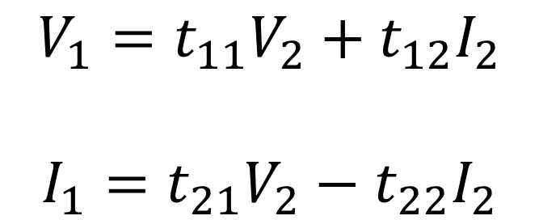
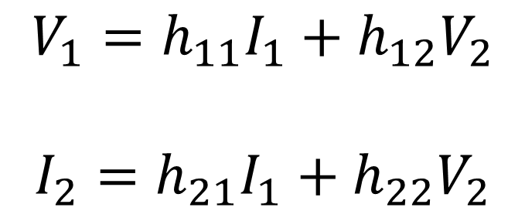
Hybrid parameters
$$V_{1}=h_{11}I_{1}+h_{12}V_{2}$$
$$I_{2}=h_{21}I_{1}+h_{22}V_{2}$$
Transmission parameters
$$V_{1}=t_{11}V_{2}+t_{12}I_{2}$$
$$I_{1}=t_{21}V_{2}−t_{22}I_{2}$$

Slide 15
